Slide 1
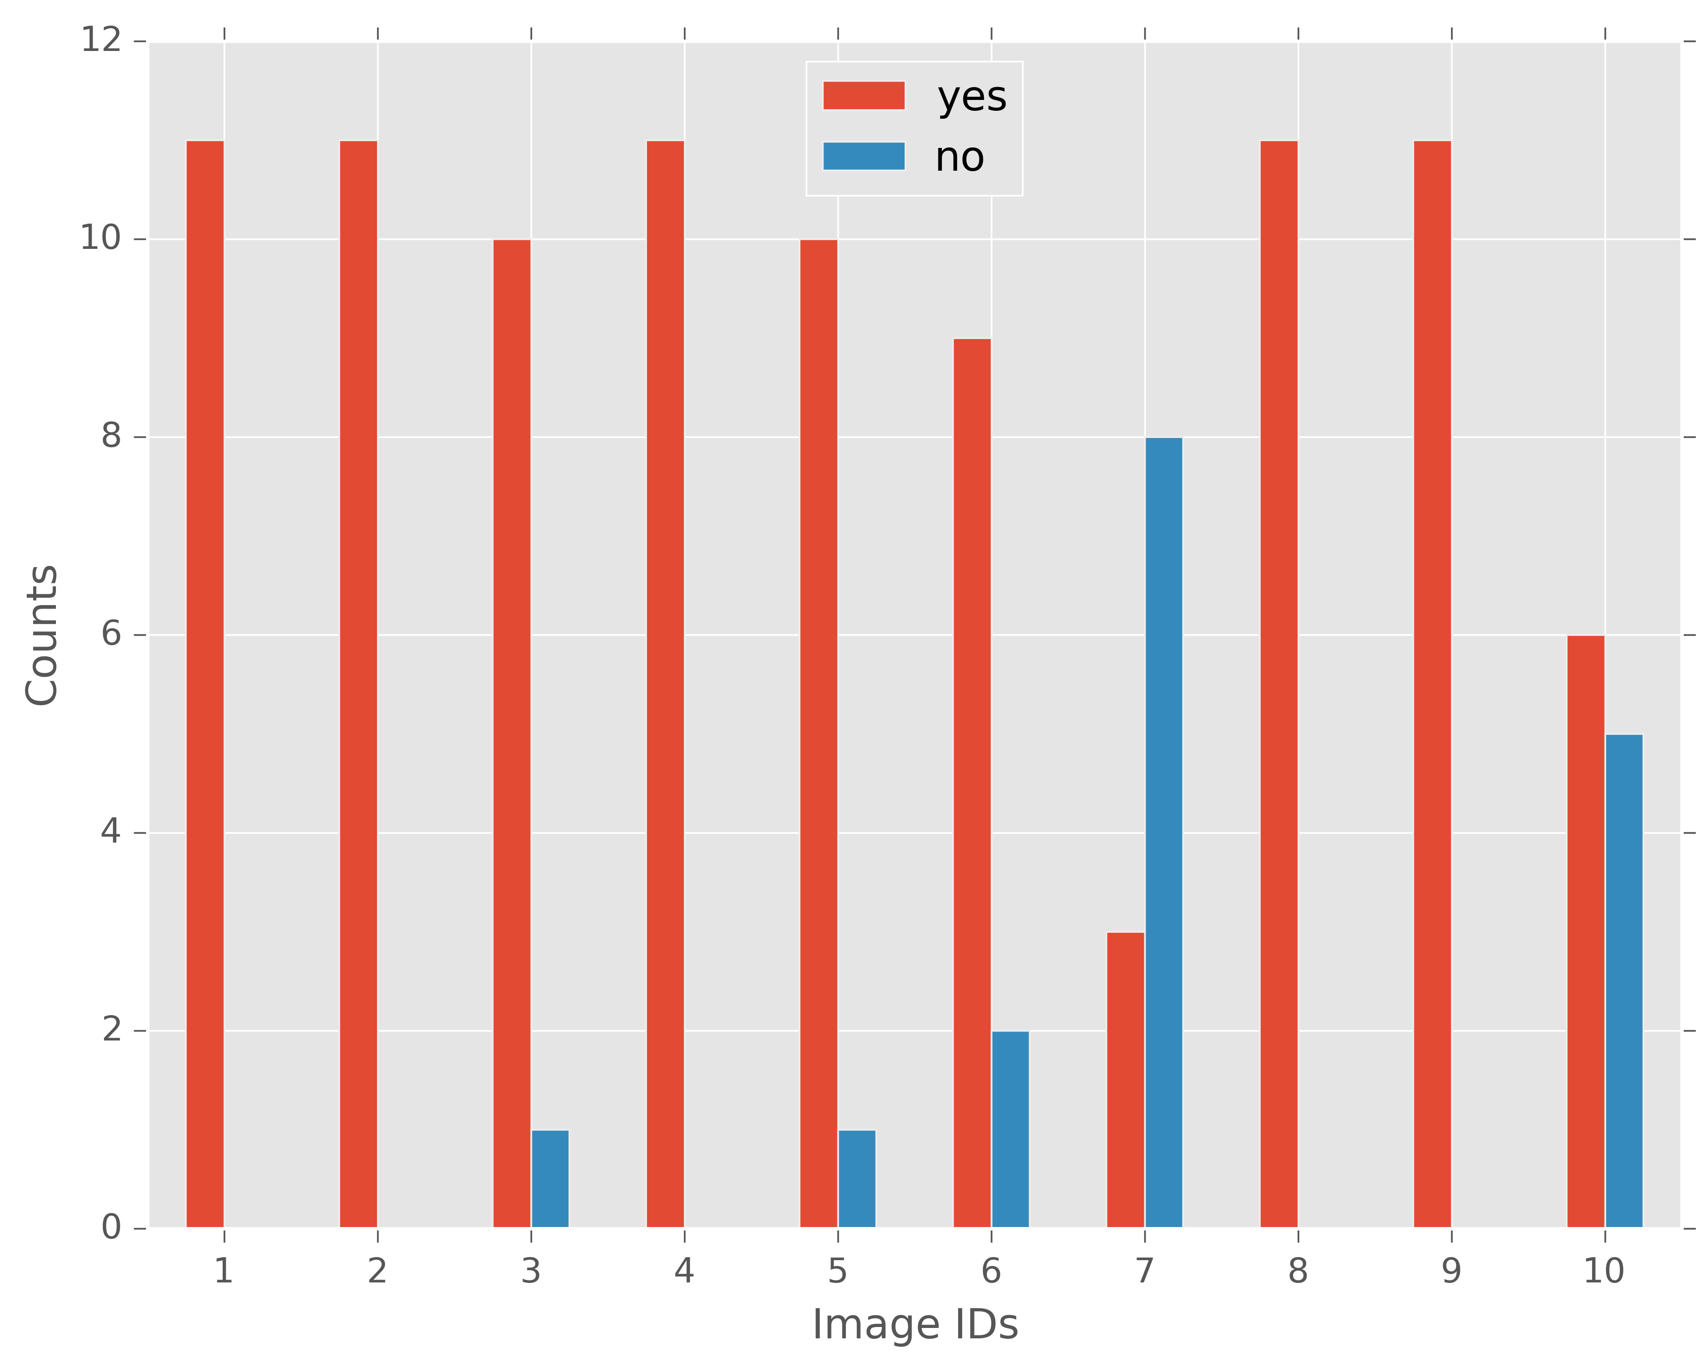
Incorrect
Prediction
High
Disagreement

Slide 2
Counts
Counts

Slide 3
Counts
Counts

Slide 4
User confidence
Predicted percent agreement with others
Voters who answered no
Voters who answered yes
Image 7

Slide 5
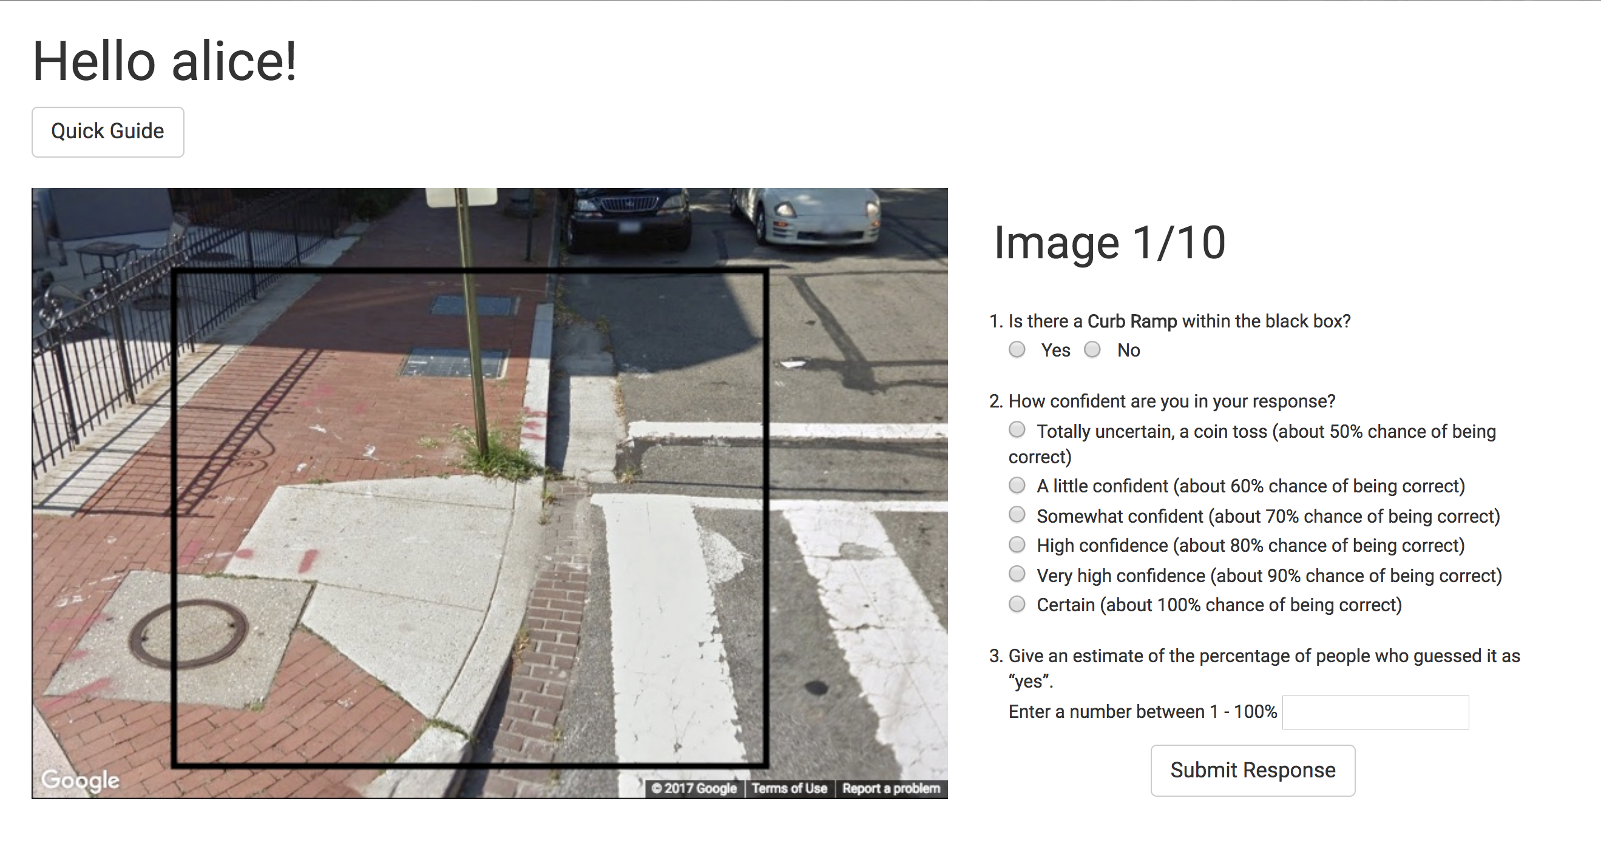

Slide 6
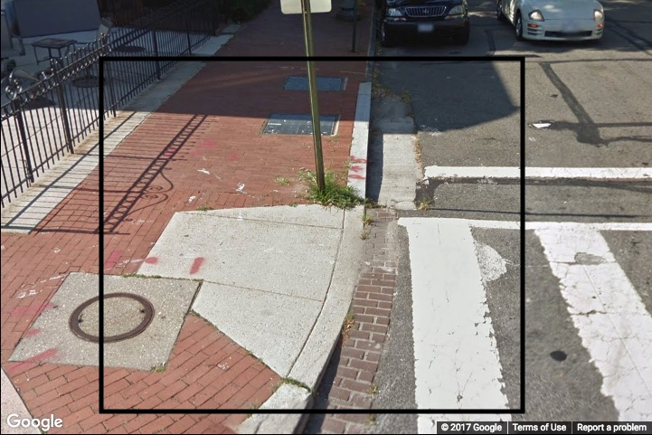
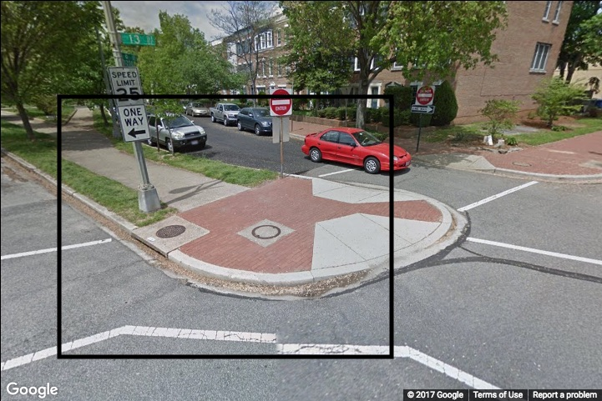
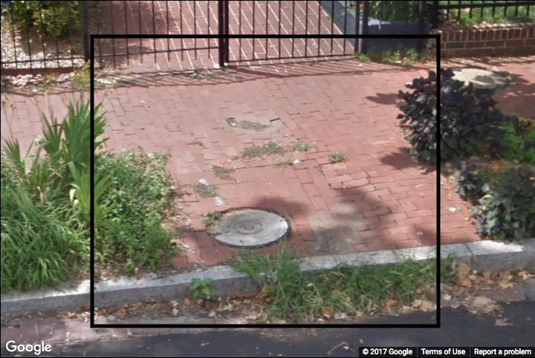
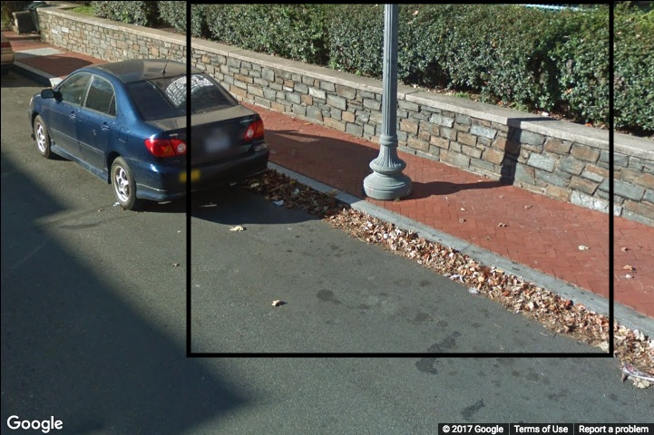
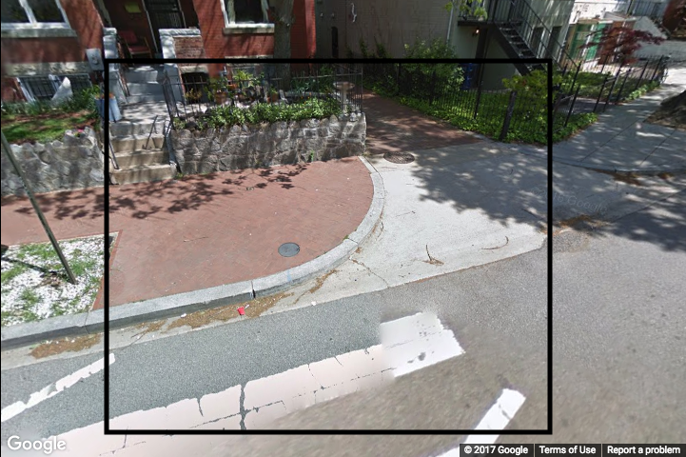
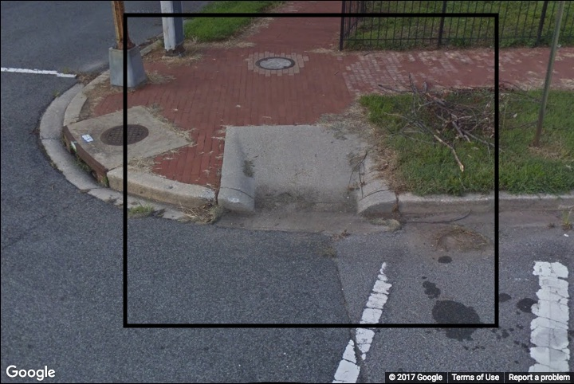
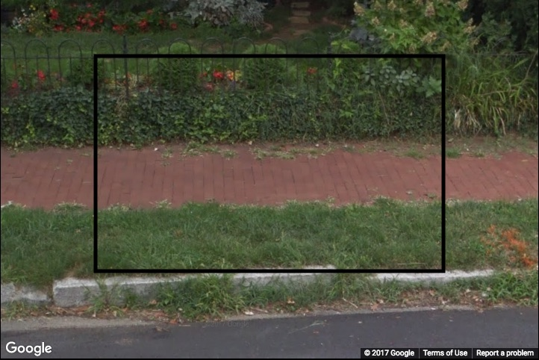
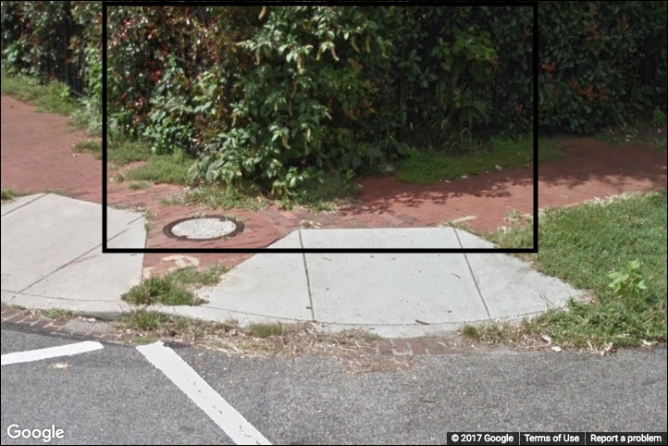
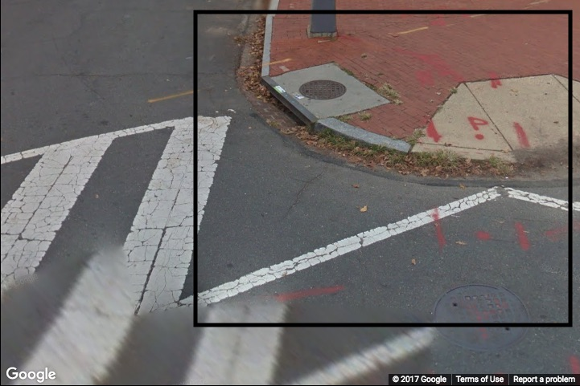
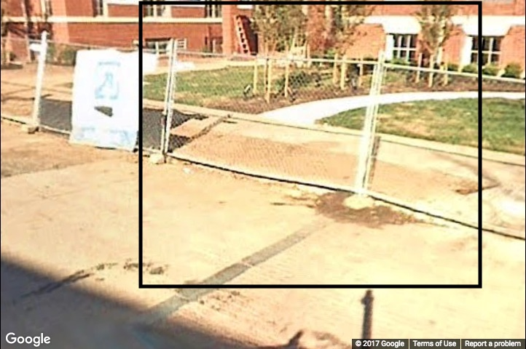
1 | CURB RAMP
2 | MISSING CURB RAMP
3 | SURFACE PROBLEM
4 | OBSTACLE IN PATH
5 | MISSING CURB RAMP
6 | CURB RAMP
7 | SURFACE PROBLEM
8 | OBSTACLE IN PATH
9 | MISSING CURB RAMP
10 | OBSTACLE IN PATH

Slide 7
7 | SURFACE PROBLEM
10 | OBSTACLE IN PATH

Slide 8
Scores
Improve

